Slide 1
File Formats in Hadoop

Slide 2
Requirements in file formats
Files should
Get read fast
Get written fast
Be Splittable i.e multiple tasks can run parallel on parts of file.
Support Schema evolution, allowing to change schema of file.
Support advanced compression through various available compression codecs (Bzip2,LZO,Snappy etc)
(No file format support all of these. There is always a trade off between one or the other.)

Slide 3
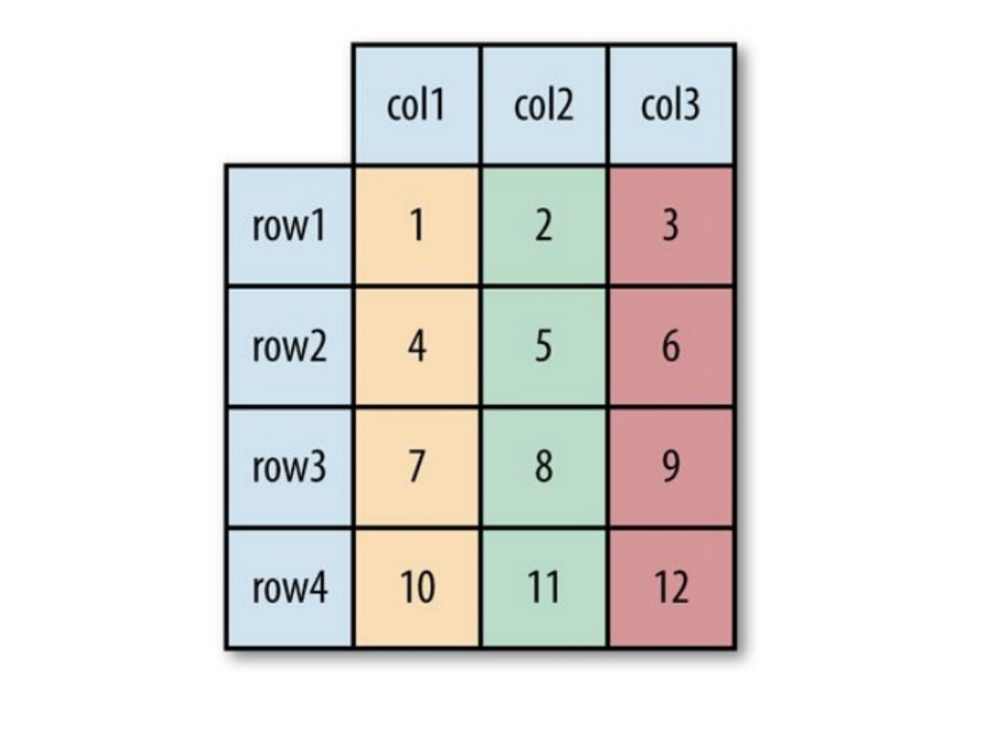
Example Dataset

Slide 4
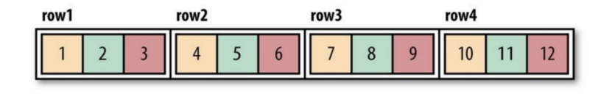
The file format in Hadoop roughly divided into two categories:
1. Row-oriented
The same row of data stored together that is continuous storage: SequenceFile, MapFile, Avro Datafile.
If only a small amount of data of the row needs to be accessed, the entire row needs to be read into the memory.
Row-oriented storage is suitable for situations where the entire row of data needs to be processed simultaneously.

Slide 5
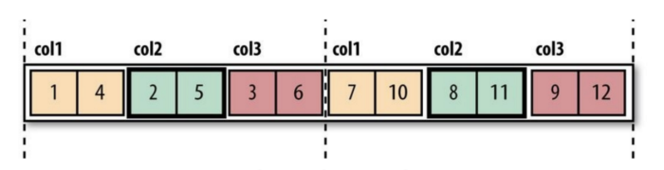
2. Column Oriented
The entire file cut into several columns of data, and each column of data stored together: Parquet, RCFile, ORCFile.
The column-oriented format makes it possible to skip unneeded columns when reading data, suitable for situations where only a small portion of the rows are in the field.
This format of reading and write requires more memory space because the cache line needs to be in memory .
It is not suitable for streaming to write, because once the write fails, the current file cannot be recovered, and the line-oriented data can be resynchronized to the last synchronization point when the write fails, so Flume uses the line-oriented storage format.

Slide 6
Text Files(CSV,TSV)
Each line is a record/data and lines are terminated by new line character (\n)
Good write performance but slow reads.
Do not support Block compression ,only file level compression like Bzip2.
Text Files are inherently splittable on \n character.
Limited schema evolution (New fields can only be appended to existing fields while old fields can never be deleted.)

Slide 7
Sequence Files
Each record is stored as a key value pair in a binary format.
Good write performance and good reading performance when reading full record.
Support block compression.
They are splittable.
Limited Schema evolution as they don’t store meta data with data like text files.(New files can only be appended to existing fields while old fields can never be deleted).

Slide 8
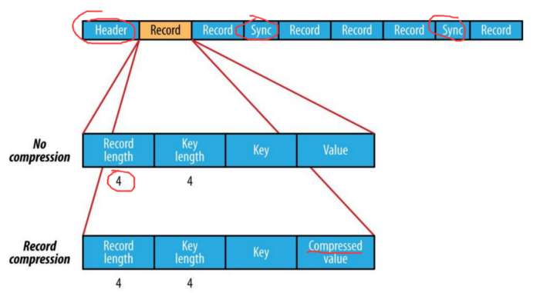
Sequence File Format
The storage format differs depending on whether it is compressed, and whether it uses record compression or block compression:

Slide 9
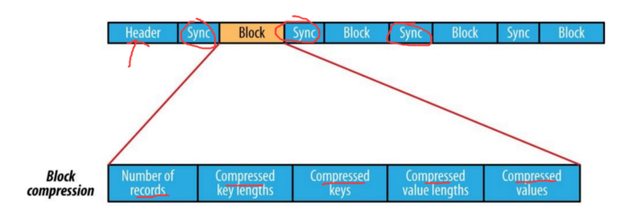

Slide 10
Avro File
It is a file format plus a serialization and desrialization framework.
It uses JSON for defining data types and serializes the data in a compact binary format.
It has average read/write performance.(so not good for I/O operations).
Supports block compression.
They are splittable.
Was mainly designed for schema evolution.Fields can be renamed,added,deleted while old files can still be read with new schema.
Avro format is a row-based storage format for Hadoop, which is widely used as a serialization platform.
Avro format is a language-neutral data serialization system. It can be processed by many languages (currently C, C++, C#, Java, Python, and Ruby).
Avro format provides rich data structures. For example, you can create a record that contains an array, an enumerated type, and a sub-record.

Slide 11
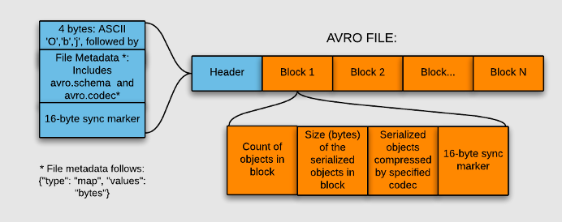

Slide 12
Columnar File Formats
In columnar file format instead of just storing rows of data adjacent to one another, we also store column values adjacent to each other.
So datasets are partitioned both horitzontally and vertically.

Slide 13
RC File
They are flat files consisting of binary key value pairs similar to sequence file.
Was developed for faster reads but with a compromise on write performance.For writing it needs more memory and computation.
Provides significant block compression, can be compressed with high compression ratios.
They are splittable.
Was mainly designed for faster reads so No schema evolution.

Slide 14
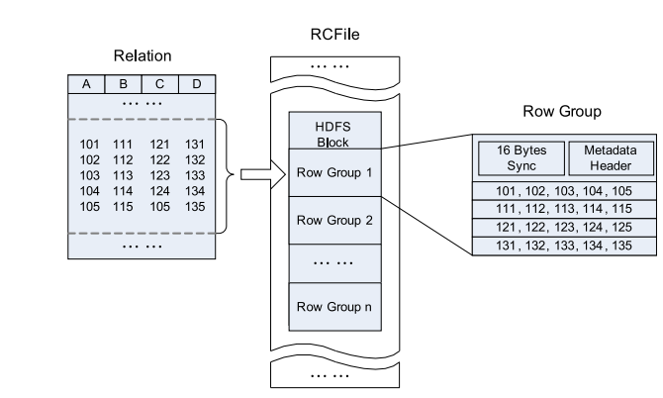
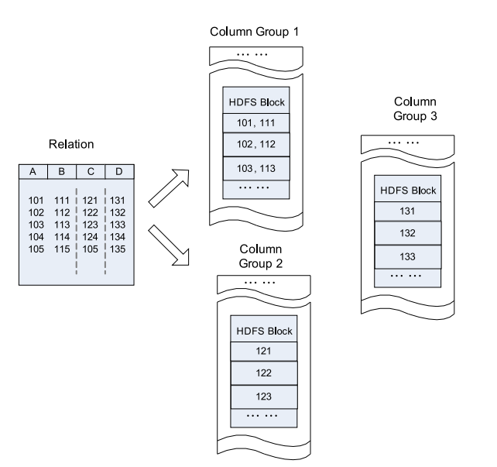
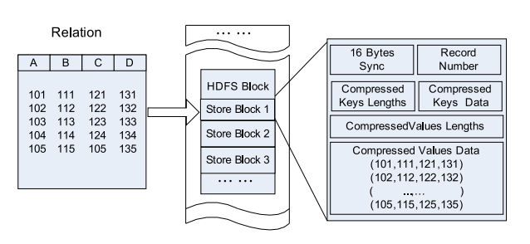
RC File
Record Columnar File, this type of file first divides the data into Row Group by row, and inside the Row Group, the data is stored in columns.
Row-Store in an HDFS Block

Slide 15
ORC File(optimised row columner)
A better version of RC file.
Was developed for faster reads but compromise on write performance (better than RC file)
Provides significant block compression .Can be compressed with high compression ratios.(better than RC file)
ORC files are splittable at stripe level.
Mainly designed for faster reads so no schema evolution.

Slide 16
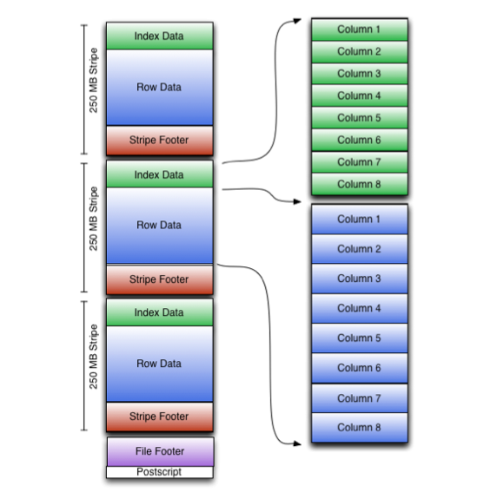
ORC File
ORCFile (Optimized Record Columnar File) provides a more efficient file format than RCFile.
It internally divides the data into Stripe with a default size of 250M. Each stripe includes an index, data, and Footer.
The index stores the maximum and minimum values ​​of each column, as well as the position of each row in the column.

Slide 17
Parquet File
Parquet, an open-source file format for Hadoop, stores nested data structures in a flat columnar format.
Compared to a traditional approach where data is stored in a row-oriented approach, Parquet file format is more efficient in terms of storage and performance.
It stores nested data structures in a flat columnar format.
Faster reads with slow writes. It is especially good for queries that read particular columns from a “wide” (with many columns) table since only needed columns are read, and IO is minimized
support compression with snappy compression most of the times.
They are conditionally splittable.
limited schema evolution (New fields can only be appended to existing fields while old fields can never be deleted).

Slide 18
Parquet
One of the unique features of Parquet is that it can store data with nested structures in a columnar fashion too.
This means that in a Parquet file format, even the nested fields can be read individually without reading all the fields in the nested structure. Parquet format uses the record shredding and assembly algorithm for storing nested structures in a columnar fashion.
Row group: A logical horizontal partitioning of the data into rows. A row group consists of a column chunk for each column in the dataset.
Column chunk: A chunk of the data for a particular column. These column chunks live in a particular row group and are guaranteed to be contiguous in the file.
Page: Column chunks are divided up into pages written back to back. The pages share a standard header and readers can skip the page they are not interested in.

Slide 19
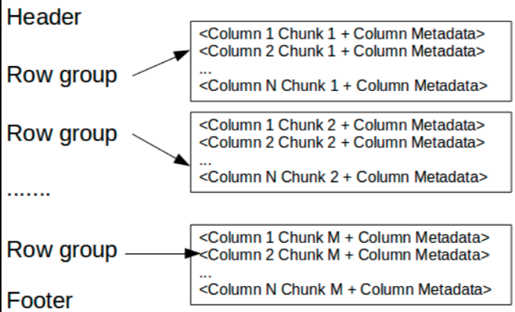
Format of Parquet

